Slide 1
Let the sun shine in our schools
connectivity and acceptance of pupils' diversity
Erasmus days 2021

Slide 2

The project
We started in 2020 four schools from france, greece, serbia and bulgaria.

Slide 3


Our aim
Was to share our experience in integration!

Slide 4
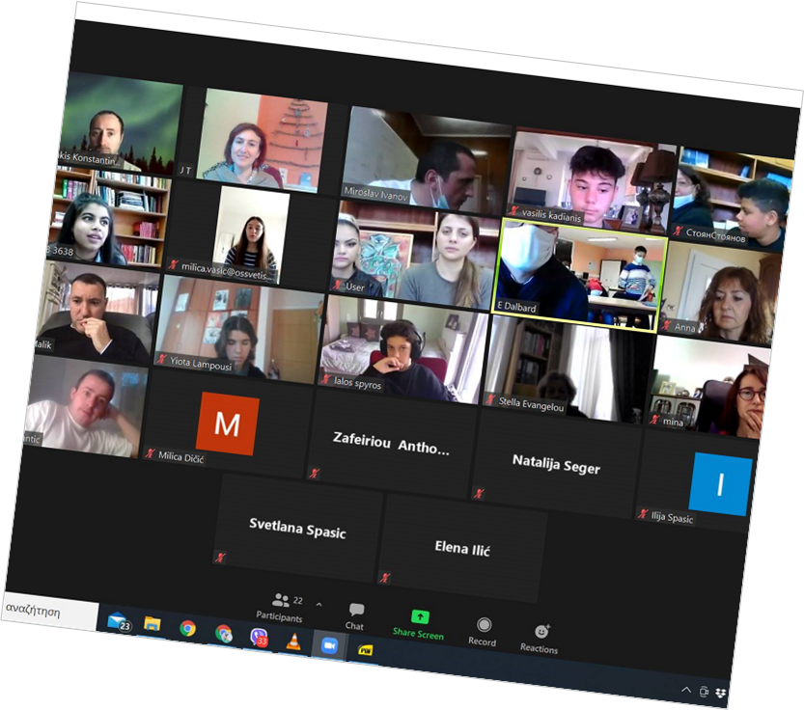
And despite ...
the hard times caused by covid – 19 pandemic we managed to be together!

Slide 5
We could be all together again!
we celebrated erasmus days because…

Slide 6
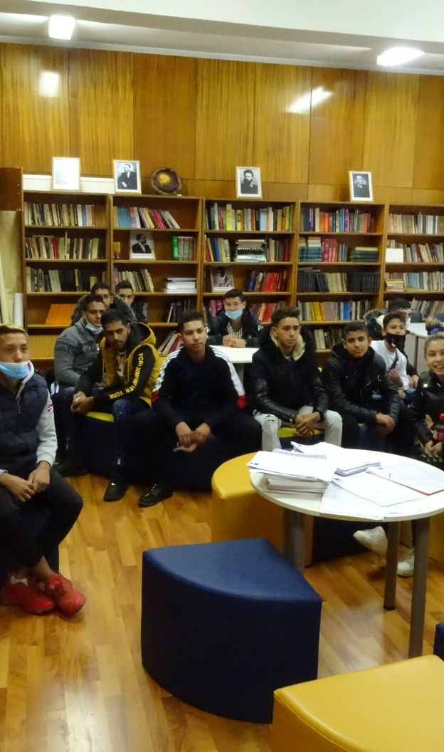
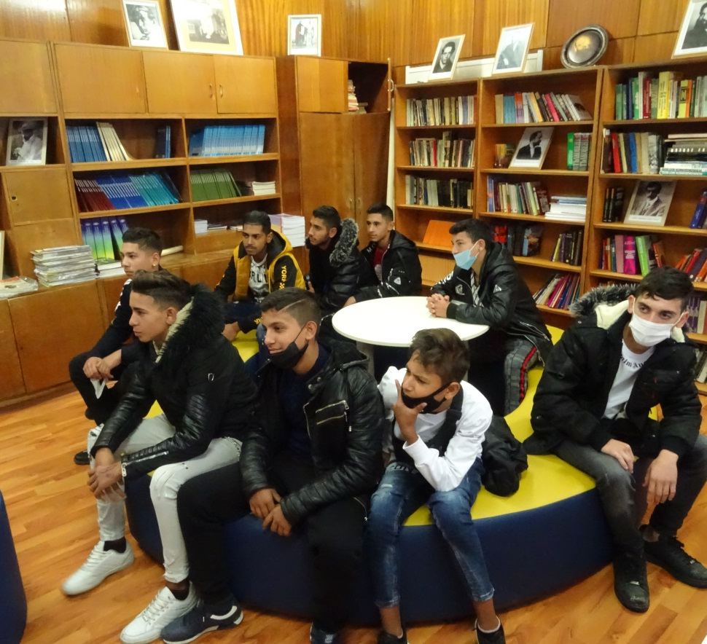
Erasmus Days 2021 celebration event Took place in Professional high school of textile and apparel “Dobri zhelyazkov” on 15th of October 2021

Slide 7
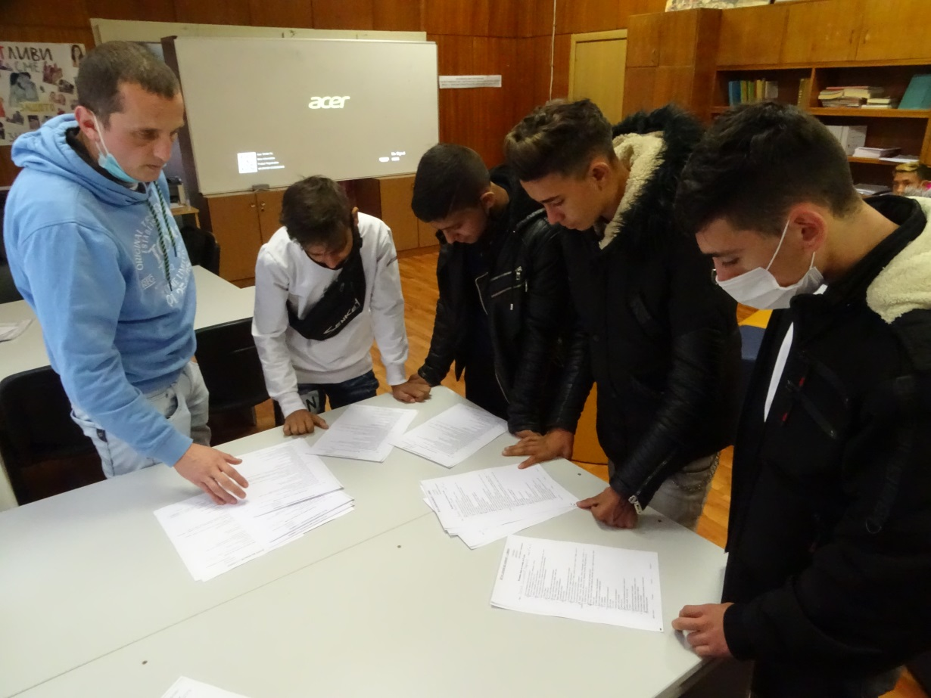
From many…
We chose Two European poems about the hope of better future…

Slide 8
Leaving is the first step towards understanding
By Alessia from Italy
Source:
https://europa.eu/youth/node/70224_en

Slide 9
The Spaces of Hope
By Ivan V. Lalic
Source: http://serbianpoets.weebly.com/the-spaces-of-hope.html

